Slide 1
Idea from NguyenNgocTu

Slide 2
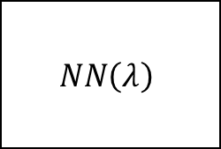

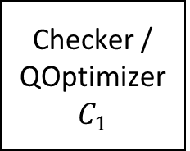
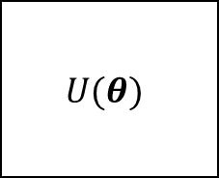



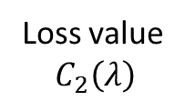
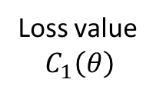
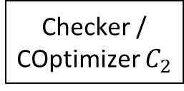
Exit classical part
Quantum embedding
$$U(θ)$$
Checker / COptimizer $C_{2}$
Input $x$
State $|\hat{x}⟩$
Update $θ$
Loss value
$$C_{1}\left(θ\right)$$
Update $λ$
Loss value
$$C_{2}\left(λ\right)$$
Checker / QOptimizer $C_{1}$
$$NN\left(λ\right)$$
Exit quantum part
End

